Slide 1
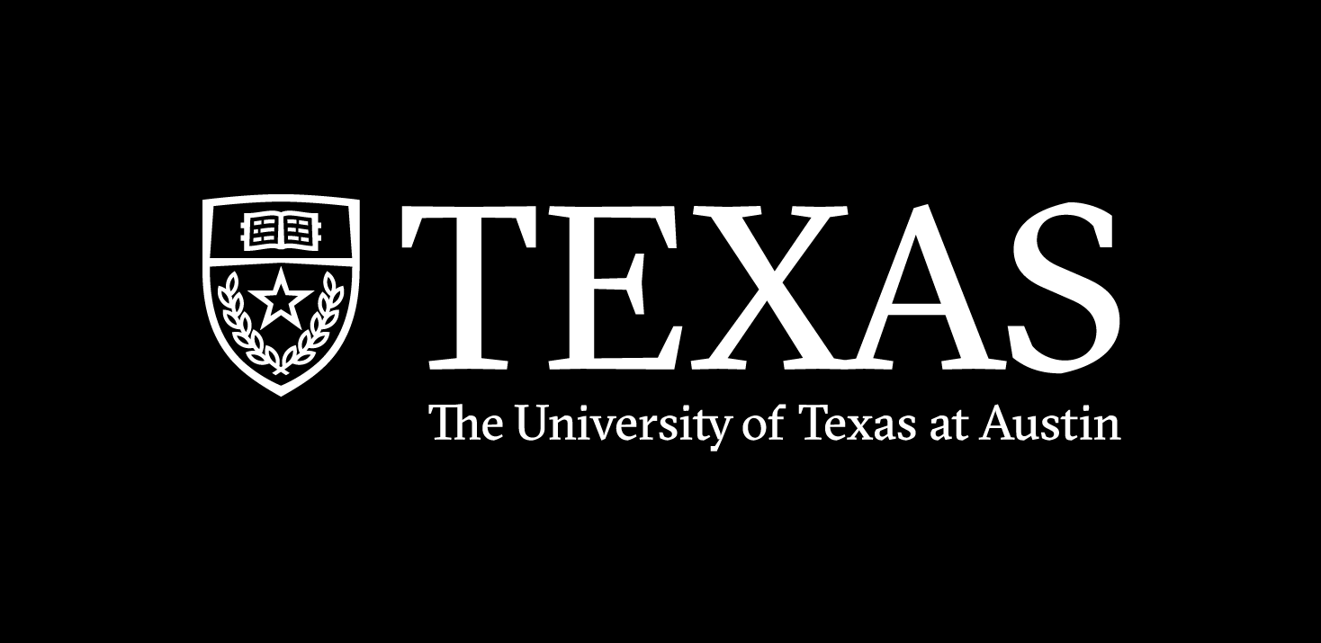
MLDS
March 8, 2025
Datahack 2025
Wind Speed Forecasting
Team “Random Forest Rangers”
Notes:
Vedant

Slide 2
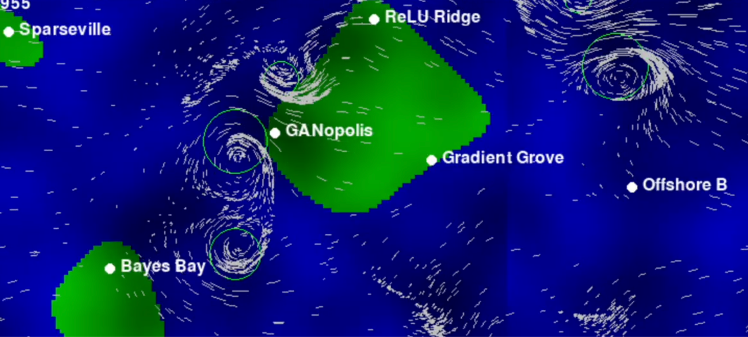
Goal
Goal 1: Forecast 5 Day Wind Speeds for GANopolis
Goal 2: Develop a pricing strategy for minimizing damage payouts
Notes:
Karan

Slide 3
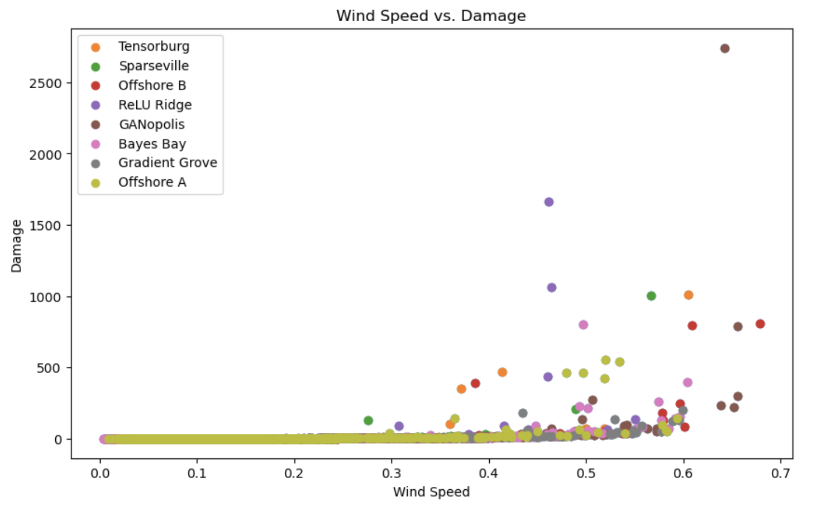
Exploratory Data Analysis

Slide 4
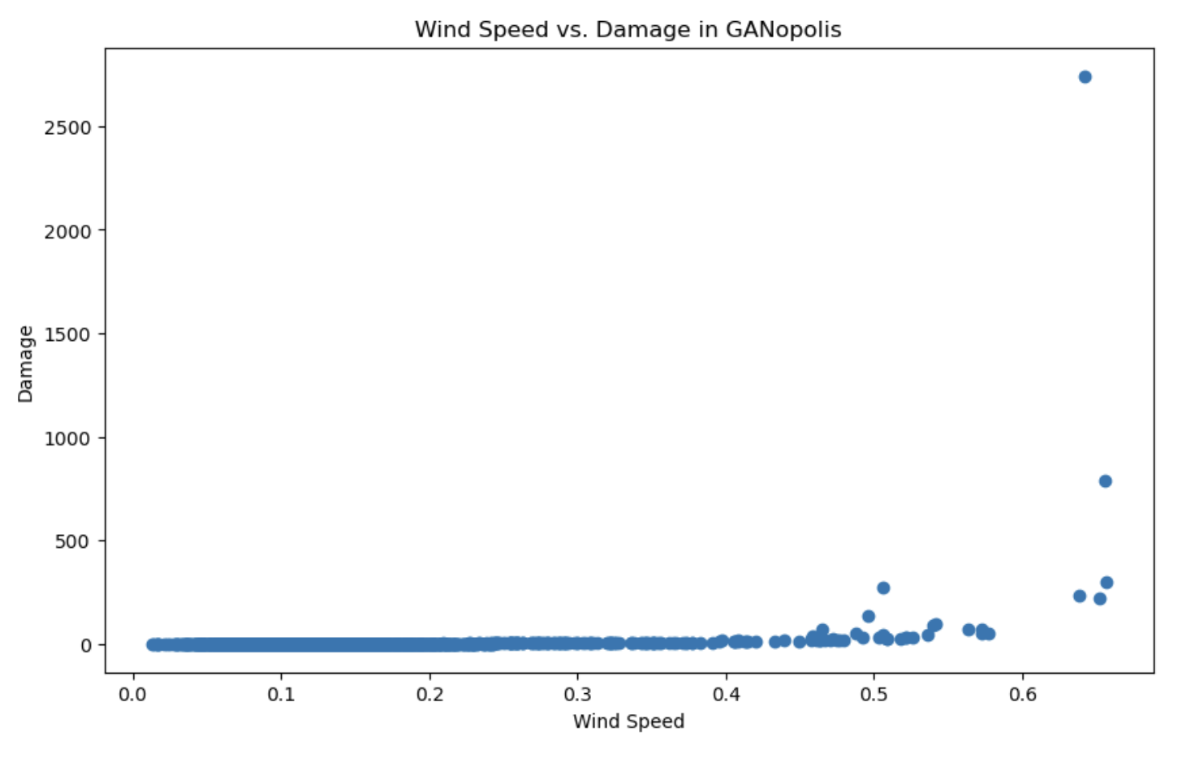
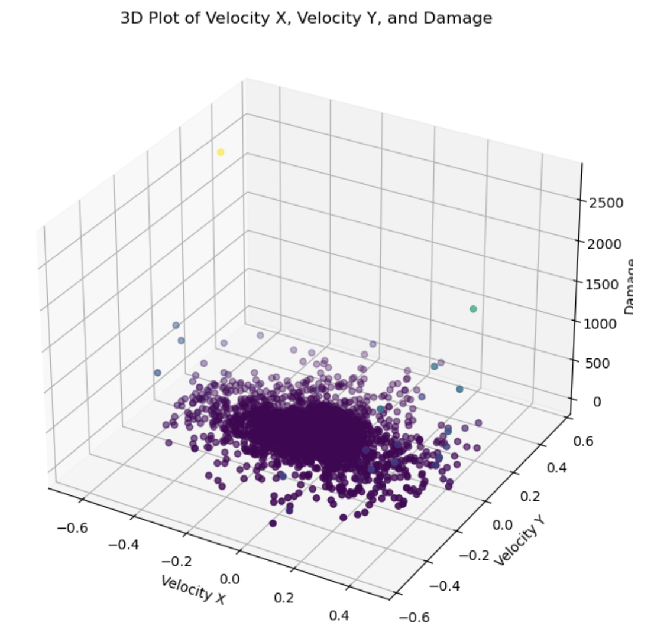
Damage vs Wind Speeds

Slide 5
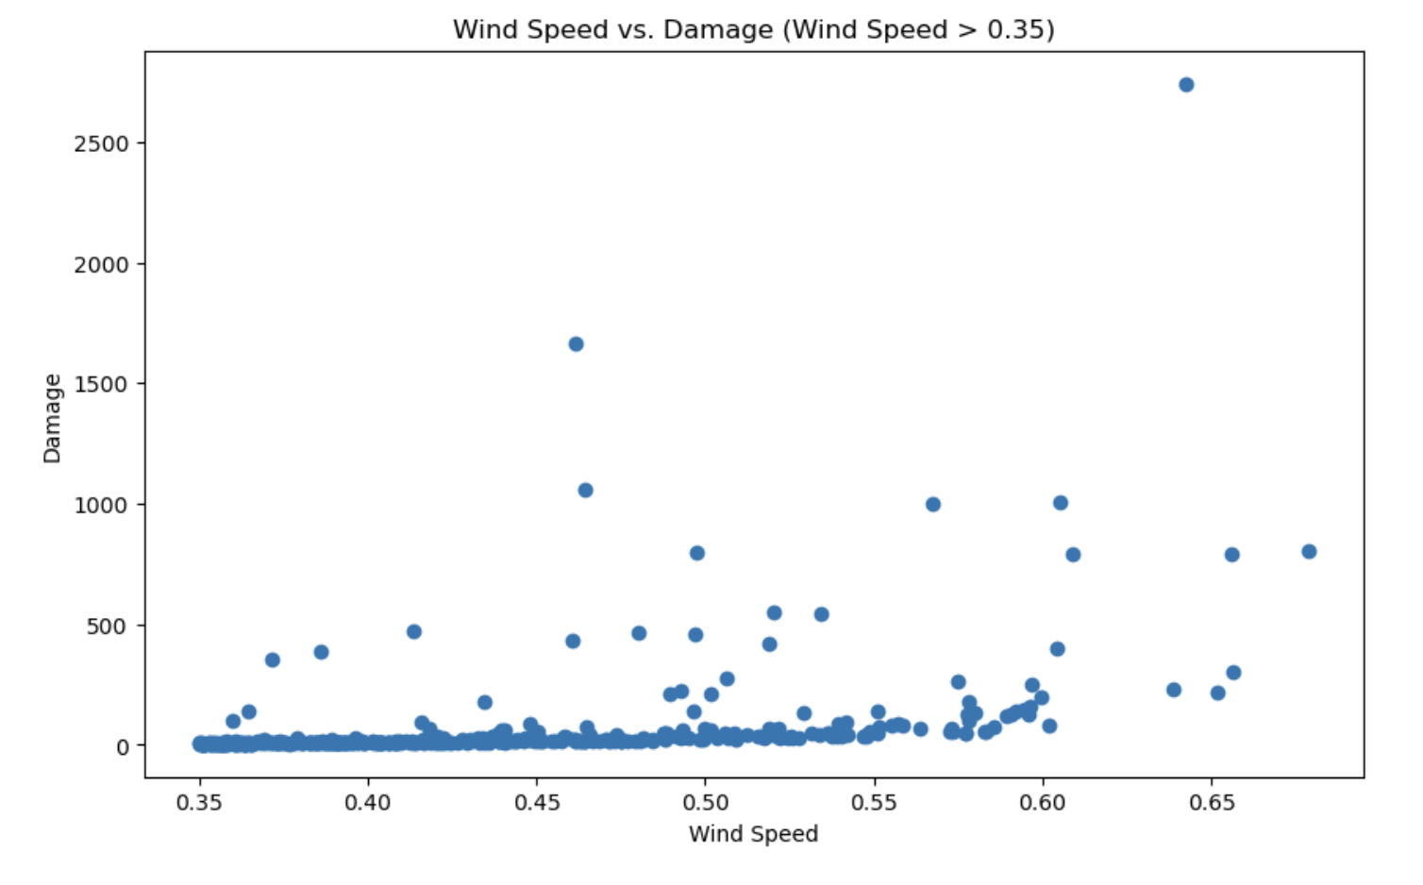
Segmenting Data

Slide 6
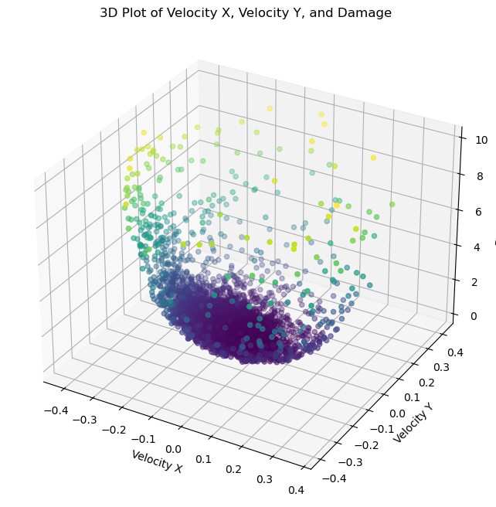
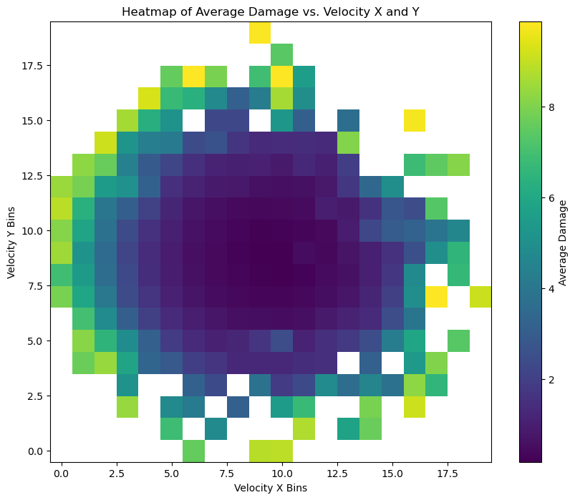
3D Visualizations

Slide 7
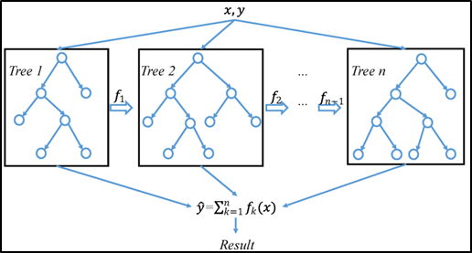
Wind Speeds: Model Implementation
Model: XGBoost
Reasoning:
Baseline (Moving Averages) is an Oversimplification
Captures Complex Patterns within data
Simple to implement (Compared to RNNs)
Optimized library
Hyperparameter Tuning
Framework:
Define Model (Using XGBoost)
Fit (Model ‘learns’ on data)
Predict (Model predicts future wind speeds)
Evaluate (use MSE in train_test_split)
XGBoost
Notes:
Karan

Slide 8
Pricing: Model Implementation
Model: Long Short Term Memory Model (LSTM)
LSTM for
Wind Prediction
Obtained Wind Predictions
LSTM for Damages
Obtained Damages
Predict Price
Notes:
predict wind speed and damage for the next hours iteratively by using the last sequence, updating the input data with the predicted values for future predictions.
We first implemented an LSTM model for wind predictions. We chose to implement this model as a preliminary method to predict wind using features of first 5 days so that we could progress on predicting price
After obtaining wind predictions, we used another LSTM to predict damages. We thought that an LSTM model would be appropriate to predict damages because it enables us to use the most recent past data over a predetermined period of time to predict future damages
Lastly, we recognized that, in order to optimize profit, we could set the derivative of the profit function equal to 0 to obtain the price that would maximize the profit.
Using our wind predictions, we chose to

Slide 9
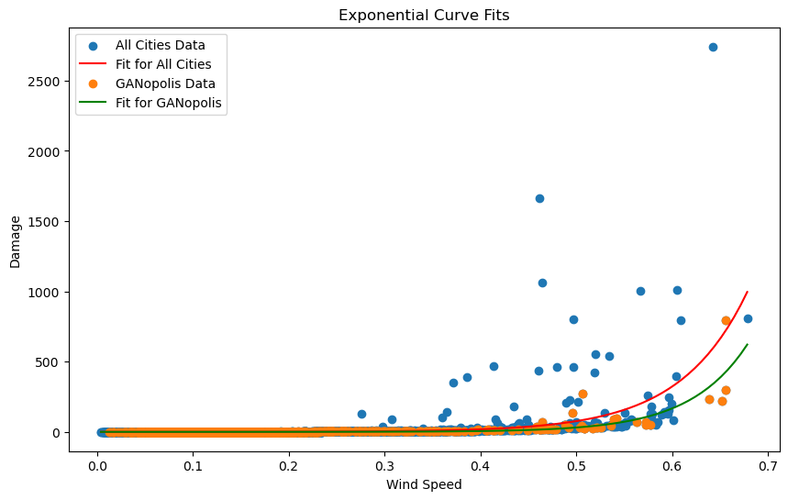
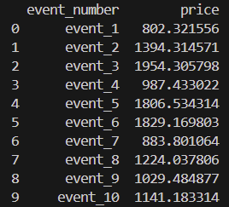
Exponential Fit

Slide 10
Challenges & Learnings
Adding ‘Lags’ in XGBoost was a challenge
Lacks built-in temporal awareness
Depends on piecewise constant models
As such, requires stricter feature engineering
Model potentially too sensitive (hyperparameter tuning)
Strict Time Constraint
Next Time, Team will take these considerations into building a robust model!
👍
Notes:
Karan

Slide 11
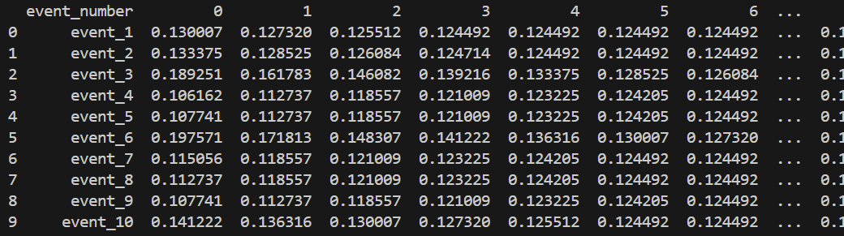
Results
Notes:
Karan

